Slide 1
Ethics in Medicine 2024
Roy Michael Stefanik, D.O.
Clinical Assistant Professor, Department of Psychiatry
Georgetown University Medical Center
rms23@georgetown.edu
703.830.1500
https://www.fairfaxmentalhealth.com/articles-other-resources

Slide 2
Ethics in Medicine 1
OPERATIONAL DEFINITIONS:
Ethics is a set of rules established by a group or organization that promotes acceptable behavior for members of that organization.
Applies to physicians, pharmacists, nurses, lawyers, accountants, plumbers, police officers, etc.

Slide 3
Ethics in Medicine 2
How are morals different from ethics?
Morals are an individual’s deeply held personal values that help him or her determine right from wrong. These can be derived from parental and family values, cultural traditions, and religious beliefs.

Slide 4
Ethics in Medicine 3
Medical ethics generally fall into several categories:
Clinical ethics - involve the patient-doctor relationship in the context of care for the patient. This involves the doctor’s relationship with the patient, the patient’s family, other health care workers, hospital administration, insurance companies, and pharmacy benefits managers.

Slide 5
Ethics in Medicine 4
Medical ethics generally fall into several categories (cont.):
Health Policy – Public policies that set the context in which physicians deliver care to patients. This can involve health insurance, access to care for the uninsured, allocation of scarce resources, public health polices (e.g., reporting communicable diseases), and state laws regarding end-of-life care and confidentiality.

Slide 6
Ethics in Medicine 5
Medical ethics generally fall into several categories (cont.):
Bioethics – refers to broader philosophical questions raised by biomedical advances.
Involves issues relating to the beginning and end of human life, all the way from issues relating to in-vitro fertilization and abortion to euthanasia and palliative care.

Slide 7
Ethics in Medicine 6
Medical ethics generally fall into several categories (cont.):
Professional ethics – codes that dictate appropriate behavior on the part of the physician. Examples:
"First, do no harm."
Hippocratic Oath - https://www.nlm.nih.gov/hmd/greek/greek_oath.html

Slide 8
Ethics in Medicine 7
Problems with the Hippocratic Oath:
No input from patients or public (i.e., highly paternalistic).
Gives patients little role in decision-making.
Does not require physicians to disclose information to patients, be truthful, not use placebos, or allow them to make informed choices.
Only 56% of US medical schools still use some variation of it - https://yaleglobalhealthreview.com/2020/11/21/the-hypocrisy-of-hippocrates-ethics-from-medical-oaths/

Slide 9
Ethics in Medicine 8
How does ethics differ from law?
Statutes, regulations, and court decisions can guide physicians as to what they may or may not do (e.g., HIPAA).
Does not always provide definitive answers to ethical dilemmas.
Criminal law identifies acts so wrong that physicians will be held legally liable. Ethics may focus on the right or best decision in a situation.

Slide 10
Ethics in Medicine 9
How does ethics differ from law (cont.)?
The law explicitly grants physicians discretion in some situations (e.g., when a patient lacks decision-making capacity, especially in an emergency situation).
The law may provide no clear guide to action on certain topics (e.g., disclosing genetic information to relatives when the patient objects to disclosure).

Slide 11
Ethics in Medicine 10
Law and ethics may differ. Examples:
Abortion
Euthanasia
Medical marijuana and isomers
Healthcare workers refusing to provide treatment on religious grounds
Gender identity
CRISPR/gene editing
Human/animal hybridization
Artificial intelligence/algorithm creation

Slide 12
Ethics in Medicine 11
Six of the values that commonly apply to medical ethics discussions:
Autonomy- the patient has the right to refuse or choose their treatment.
Beneficence - a practitioner should act in the best interest of the patient.
Non-maleficence - “First, do no harm."

Slide 13
Ethics in Medicine 12
(Cont.)
Justice- concerns the distribution of scarce health resources and the decision of who gets what treatment (fairness and equality).
Dignity- both the patient and the person treating the patient have the right to be valued and respected.
Truthfulness and honesty - For instance, the concept of informed consent. Can the patient realistically make decisions regarding care?
***BENEFICENCE (PATERNALISM) VS. AUTONOMY – Utilitarianism vs. the rights of the individual***

Slide 14
Ethics in Medicine 13
Case 1- An elderly woman with severe dementia develops pneumonia. Her daughter insists that hospitalization and administration of antibiotics is pointless and that the patient would not want such “heroics.” Her son, however, demands that her pneumonia be treated because he believes that life is sacred.

Slide 15
Ethics in Medicine 14
Case 1 (cont.):
Should the physician withhold or administer antibiotics?
Who should be patient’s surrogate when she cannot speak for herself?
Furthermore, what are the reasons that the physician can give to justify the decision to the patient’s children and to other health care workers caring for the patient?

Slide 16
Ethics in Medicine 15
Case 1 (cont.):
Most states allow physicians to determine when a patient lacks decision-making capacity and thus, when a surrogate should take over the role of making the decision with the physicians.
***IF YOU DON’T KNOW WHAT TO DO, ASK FOR HELP.***

Slide 17
Ethics in Medicine 16
Case 2: A 32 year old man with a positive test for human immunodeficiency virus (HIV) antibodies refuses to notify his wife. “If she finds out, it will destroy our marriage.” Although maintaining patient confidentiality is important, it seems cruel not to warn the wife that she is at risk for a fatal infection. What are the reasons that justify the physician’s decision?

Slide 18
Ethics in Medicine 17
Case 2 (cont.):
Some states give physicians discretion whether to override confidentiality to protect partners of HIV-infected persons. In these circumstances, physicians must turn to ethical and clinical considerations, not legal ones. In Virginia, you are required to disclose it to the state health department but are not required to disclose to anyone else.
http://www.hivlawandpolicy.org/states/virginia

Slide 19
Ethics in Medicine 18
Case 2 (cont.)
Do health care workers have to disclose their HIV status?
In general, according to case law and professional practice guidelines (such as from the AMA), health care workers have a duty to inform patients or employers that they are HIV positive if they perform invasive or "exposure-prone" procedures on patients.

Slide 20
Ethics in Medicine 19
Case 3: A 67 year old man with chronic obstructive lung disease (COPD) has dyspnea after walking one block. He is on an optimal medical regimen of inhaled bronchodilators and corticosteroids. His resting arterial O₂ level is 67 mm Hg and it does not decrease with exercise. This exceeds the level that qualifies for Medicare coverage of home oxygen. The patient pleads, “Can’t you just write that the oxygen level is 65? I need to do something about this breathing.”

Slide 21
Ethics in Medicine 20
Case 3 (cont.)
The Medicare criteria for home oxygen is clear: an arterial oxygen level of under 65 mm Hg. Giving false information to obtain Medicare coverage is considered fraud. Physicians should follow the law.
Professional ethics, however, requires physicians to go beyond their legal duties, to act with compassion and respect, and to respond to the patient’s distress, such as in cases of acute COVID infections.
New criteria: The patient must be recorded for a minimum of 2 hours and desaturate to ≤88% for at least 5 minutes to qualify for oxygen therapy (Does not need to be continuous. Can be done via nocturnal oximetry).

Slide 22
Ethics and Medicine 21
Case 4:
A physician goes to a pharmacy one evening to pick up a prescription for her teenage son’s antibiotic. When she finds out there are no refills and it is not an emergency, she informs the pharmacist she will authorize the refill. The pharmacist refuses. The physician becomes angry and threatens to report the pharmacist to the Virginia Board of Medical Professions.

Slide 23
Ethics in Medicine 22
Case 4 (cont.):
A physician can prescribe to him or herself or a family member if he or she maintains a patient record indicating a practitioner-patient relationship.
A physician cannot prescribe controlled drugs to his or herself. S/he cannot to family members except in emergency situations.
https://www.dhp.virginia.gov/medicine/medicine_faq.htm

Slide 24
Ethics in Medicine 23
Case 5:
At the end of a visit, a patient hands to the doctor a small gift-wrapped box in deep gratitude for the care the patient and family has received over the years. When the doctor opens it, it is a $3,000 Rolex watch.

Slide 25
Ethics in Medicine 24
Case 5 (cont.):
The role of accepting gifts is an extremely complex one in the medical profession. To turn away a small gift could be perceived as a rejection of the patient’s well-meaning act and could be hurtful to the patient-doctor relationship.

Slide 26
Ethics in Medicine 25
Case 5 (cont.):
On the other hand, physicians should not accept expensive gifts that potentially exploit vulnerable patients. In addition, it may put the physician at risk of feeling a need to reciprocate in turn with granting favors, inappropriate prescribing, boundary-crossing, or other behaviors that are potentially harmful to the doctor-patient relationship.
*Another (unrelated) example of an ethical dilemma: The authorization of the use of emotional support animals

Slide 27
Ethics in Medicine Part 1 26
Case 6:
A 29-year-old man with a history of multiple bowel surgeries is been seen for severe depression and chronic pain. He has recently begun smoking medical-grade marijuana he received from a physician in another state. It becomes apparent that his pain management is being provided by multiple doctors with little or no collaboration of care.

Slide 28
Ethics in Medicine Part 1 27
Legalization (and in particular, the medicalization) of marijuana has become a complicated issue. Medical use of marijuana, under certain circumstances, has the potential to provide pain relief and physical symptoms such as muscle spasticity in multiple sclerosis or nausea from cancer chemotherapy. It is currently a Schedule I drug federally due to its abuse potential.

Slide 29
Ethics in Medicine Part 1 28
Drawbacks:
Don’t know dosage, frequency, duration of treatment.
No standardization of treatment or even dosage form.
Abuse potential and withdrawal symptoms from discontinuation well documented.
Diversion risk.

Slide 30
Ethics in Medicine 29
Should medical and/or recreational marijuana be legalized nationwide?
The California medical marijuana law, passed through voter referendum (Proposition 215) in 1996, permitted the use of marijuana for “cancer, anorexia, AIDS, chronic pain, spasticity, glaucoma, arthritis, migraine, or any other illness for which marijuana provides relief.”
Nationwide explosion since…

Slide 31
Ethics in Medicine 30
FDA News Release, November 1, 2017:
“The FDA has grown increasingly concerned at the proliferation of products claiming to treat or cure serious diseases like cancer. In this case, the illegally sold products allegedly contain cannabidiol (CBD)…CBD is marketed in a variety of product types, such as oil drops, capsules, syrups, teas, and topical lotions and creams. The companies receiving warning letters distributed the products with unsubstantiated claims regarding preventing, reversing or curing cancer; killing/inhibiting cancer cells or tumors; or other similar anti-cancer claims. Some of the products were also marketed as an alternative or additional treatment for Alzheimer’s and other serious diseases.”

Slide 32
Ethics in Medicine 31
News Leader, February 5, 2018 - RICHMOND — The Virginia Senate voted unanimously Monday to pass the Joint Commission on Health Care bill SB 726, which will let Virginia doctors recommend the use of cannabidiol oil or THC-A oil for the treatment of any diagnosed condition or disease.
Despite widespread availability and use of CBD products, they can often cause urine drug screens to test positively for THC.

Slide 33
Ethics in Medicine 32
Ever-changing issue in VA and US with multiple variations as to how to control and regulate use – now legal in VA with medical card. Challenges abound with providing mental health care to those who actively use marijuana, often to self treat…
Duel-edged sword – uncertain how it will play out nationally long-term, especially since employers can still fire employees who use, even if it’s legal in that jurisdiction - (From 3/19/2021- https://www.nbcnews.com/politics/white-house/five-staffers-fired-over-marijuana-use-white-house-says-n1261578)
Ketamine use?

Slide 34
Ethics in Medicine 33
What factors may influence the physician’s decision making or recommendations?
Prior experiences
Physician’s and patient’s tolerance of risk (e.g., Lamictal, choice of medical specialties)
Personality style of the physician (e.g., ER vs. pathology)
Potential legal ramifications

Slide 35
Ethics in Medicine 34
Legal concept of informed consent:
Mr. T is an 88-year-old man with severe chronic obstructive pulmonary disease (COPD), coronary artery disease, and peptic ulcer disease. He develops an adenocarcinoma of the lung which could be treated with surgery or radiation therapy.

Slide 36
Ethics in Medicine 35
His physician is reluctant to recommend surgery because of the patient’s increased operative risk. In addition, his COPD is so severe that he might be short of breath after a pneumonectomy. When his doctor discusses alternatives for treatment, Mr. T says, “Do what you think is best. You’re the doctor.”

Slide 37
Ethics in Medicine 36
What is informed consent? It is the process by which the treating health care provider discloses appropriate information to a competent patient so that the patient may make a voluntary choice to accept or refuse treatment.

Slide 38
Ethics in Medicine 37
It is generally accepted that informed consent includes a discussion of the following elements:
The nature of the decision/procedure
Reasonable alternatives to the proposed intervention
The relevant risks, benefits, and uncertainties related to each alternative
Assessment of patient understanding
The acceptance of the intervention by the patient

Slide 39
Ethics in Medicine 38
Informed Consent:
Possible options for the patient -
Agreement with the physician’s recommendations
Right to refuse interventions
Choice among alternatives
Shared decision making

Slide 40
Ethics in Medicine 39
Informed consent :
Reasons for need to address it -
Respect patient’s self determination
Enhance patient’s wellbeing
Fulfill legal requirements

Slide 41
Ethics in Medicine 40
Problems with informed consent:
Some patients do not understand medical information
Some patients do not want to make decisions (see prior case)
Patients might not want to make decisions individually
Patients often decide without deliberating about risks and benefits
Patients cannot anticipate how they will react to future conditions
Patients make decisions that contradict their best interests

Slide 42
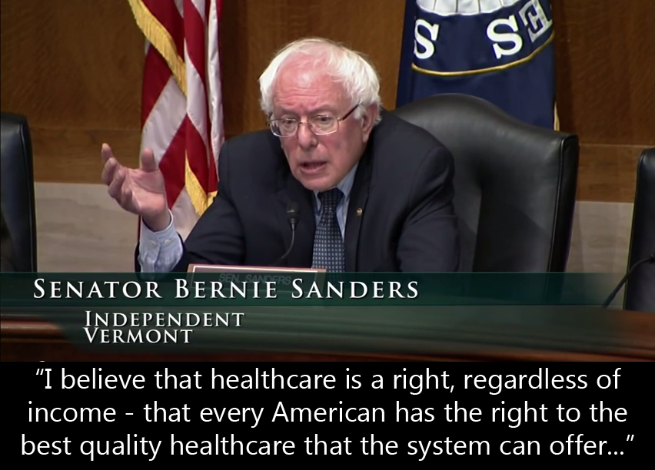
Ethics in Medicine 41
Is health care a right or a privilege?

Slide 43
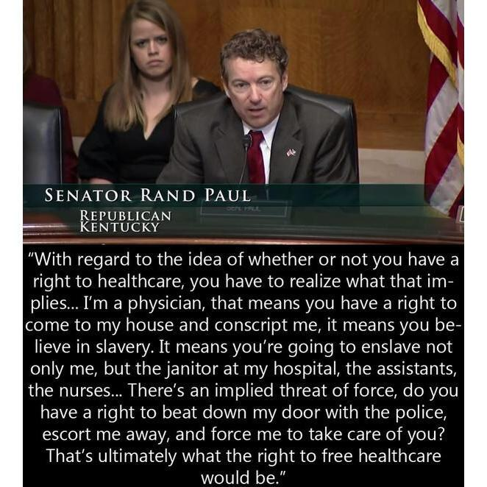
Ethics in Medicine 42

Slide 44
Ethics in Medicine 43
A 56 year old man has been disabled with chronic back pain for 10 years. Extensive evaluations including an MRI have been negative. Exercise and physical therapy have provided only minor improvement. After changing health insurance plans, the patient visits a new physician and requests a refill for eight 160 mg. tablets of oxycodone (Oxycontin) daily.

Slide 45
Ethics in Medicine 44
He says that he has not changed the dosage in several years. His new physician does not prescribe opioids at this strength and dosage for chronic pain. She wants to wean the patient off opioids and to help him live an active life despite the pain. The patient refuses a referral to a pain clinic. “I know that Oxycontin works. Nothing else helps me,” he states.

Slide 46
Ethics in Medicine 45
Risks of treatment are significant. These include abuse, diversion, addiction, and lack of objective data to assess pain. Benefits to the patient are also significant. These include reduction of severe pain and enhancing function.
February 24, 2017 - The number of deadly heroin overdoses in the United States more than quadrupled from 2010 to 2015, as the price of the drug dropped and its potency increased. There were 12,989 overdose deaths involving heroin in 2015, according to the National Center for Health Statistics, compared with 3,036 such fatalities five years earlier.

Slide 47
Ethics in Medicine 46
Confidentiality:
A 32 year old woman is admitted to the hospital after a serious MVA. She is disoriented and confused. The patient’s sister requests that the patient’s husband not be given any information. The patient has previously told the physician about her hostile divorce proceedings. The husband, however, learns that she is hospitalized and inquires about her condition.

Slide 48
Ethics in Medicine 47
Confidentiality (Cont.):
HIPAA privacy regulations as well as state privacy laws indicate a need to notify patients that relatives will be informed in an emergency unless the patient requests that they not be. In ethical terms, the physician can presume that patients would want their relatives notified. In this case, the presumption no longer holds. The physician should refer the husband to the patient’s sister or other relatives for details.

Slide 49
Ethics in Medicine 48
Confidentiality (Cont.) – When to disclose?
Disclosure to relatives and friends?
Information about public figures?
Omitting sensitive information from medical records?
Overriding confidentiality to protect third parties?

Slide 50
Ethics in Medicine 49
Avoiding deception and nondisclosure:
Mr. Z, a 75 year old Cantonese-speaking man, with a change in bowel habits and weight loss is found to have a carcinoma of the colon. The daughter and son ask the physician not to tell their father that he has cancer. They say that people in his generation are not told they have cancer and that if Mr. Z is told he will lose hope.

Slide 51
Ethics in Medicine 50
Reasons for deception or non-disclosure:
May prevent serious harm to patient (e.g., lose hope, refuse treatment, or become depressed)
Deception is culturally appropriate:
Percentage of patients who want to be told if they have cancer:
87% of European Americans
89% of African Americans
65% of Mexican Americans
47% of Korean Americans
3. Deception may enhance patient autonomy

Slide 52
Ethics in Medicine 51
Reasons against deception and non-disclosure:
Most patients want to know their diagnosis and options for care (94% of US patients)
Patients need information for decisions
Disclosure is more beneficial than harmful consequences
Deception and non-disclosure require more deception
Deception and non-disclosure might be impossible, especially in a hospital setting

Slide 53
Ethics in Medicine 52
Deceiving a patient to administer needed information:
Mr E., a 32-year-old man with bipolar disorder, discontinued his medications and developed mania. He formed a specific plan to murder his father and kill himself. Mr. E’s sister persuaded him to come to the emergency department (ED) but he would not let anyone touch him or examine him and refused medications or admission.

Slide 54
Ethics in Medicine 53
Deceiving a patient to administer needed information (cont.)
She said that previous violent confrontations with ED staff during periods of mania had caused physical and psychological injury. Mr. E’s sister agreed to injecting haloperidol and lorazepam into a sealed juice container and gave him the juice. These events were documented in the medical record. Mr. E accepted the drink, and 45 minutes later was calm, cooperative, and agreeable to psychiatric hospitalization.

Slide 55
Ethics in Medicine 54
Reasons in favor of deception:
There are no less problematic alternatives (last resort)
Medication would restore patient’s ability to make an informed decision
The patient’ surrogate authorizes deception

Slide 56
Ethics in Medicine 55
Reasons against deception:
Slippery slopes
Long-term and indirect consequences/potential for abuse
Legal/moral objections

Slide 57
Ethics in Medicine 56
Disagreements in care:
Mr. H was a 29-year-old man with end-stage cystic fibrosis who was admitted to the hospital for antibiotics and respiratory therapy He was emaciated, required home oxygen, and was short of breath walking around his home. During conversations, he often paused to catch his breath or to cough up thick secretions. Lung transplantation was not an option for him because of recurrent aspiration pneumonia. He requests that “everything be done, because I’m not ready to die until the Good Lord tells me it’s time.”

Slide 58
Ethics in Medicine 57
Ethical considerations:
Requests that “everything be done” – define
Religious based insistence on interventions
Request for interventions that cause the patient’s suffering

Slide 59
Ethics in Medicine 58
Recommendations:
Understand the patient’s or surrogate’s perspective
Respond to the patient’s or surrogate’s needs or emotions
Be sensitive to cultural and religious issues
Use time constructively
Find common ground for ongoing care

Slide 60
Ethics in Medicine 59
Florida ‘gun gag’ law provisions struck down by appeals court
February 23, 2017 - The 11th U.S. Circuit Court of Appeals has struck down key portions of a Florida law that restricted the ability of physicians to communicate freely with their patients about firearms safety. In an en banc decision (i.e., all the judges in the court) overturning an earlier three-judge panel ruling, the court ruled that Florida’s Firearms Owners’ Privacy Act infringes on the free speech rights of physicians.

Slide 61
Ethics in Medicine 60
January 22, 2019 - The New York State Senate passed the Reproductive Health Act. Signed by Democratic governor Andrew Cuomo, who has long pushed for expansive abortion-rights legislation, the bill expands the state’s already liberal abortion regime to allow late-term abortions when “the patient is within twenty-four weeks from the commencement of pregnancy, or there is an absence of fetal viability, or the abortion is necessary to protect the patient’s life or health.”
The legislation provides a further exception to permit abortion at any point during pregnancy if a health-care practitioner deems it necessary for the mother’s life or health — the exception that was defined in Roe companion case Doe v. Bolton as “all factors — physical, emotional, psychological, familial, and the woman’s age — relevant to the wellbeing of the patient.” In other words, abortion will be available to women essentially on demand up to the point of birth. The RHA will also decriminalize abortion, moving it from the state’s criminal code to the public-health code.

Slide 62
Ethics in Medicine 61
January 28, 2019 - Chinese investigators have determined that the doctor behind the reported birth of two babies whose genes had been edited in hopes of making them resistant to the AIDS virus acted on his own and will be punished for any violations of the law, a state media report said Monday.
Emails obtained by The Associated Press show Chinese scientist He Jiankui told Nobel Prize-winning scientist Craig Mello about the gene-edited babies in April 2018, months before the claim became public. Mello objected to the experiment and remained an adviser to He’s biotech company for eight more months before resigning.
December 30, 2019 - He Jiankui was sentenced to three years in jail for “illegal medical practices.”

Slide 63
Ethics in Medicine 62
On January 30, 2020, the International Health Regulations Emergency Committee of the World Health Organization declared the outbreak of Coronavirus a “public health emergency of international concern.” On 1/31/2020, then Health and Human Services Secretary Alex M. Azar II declared a public health emergency for the United States to aid the nation’s healthcare community in responding to 2019-nCoV.
5/11/2023 – Federal lifting of pandemic restrictions

Slide 64
Ethics in Medicine 63
Recommended Texts:
Resolving Ethical Dilemmas – A Guide For Clinicians – Bernard Lo, MD
Case Studies in Biomedical Ethics – Decision-Making, Principles, and Cases – Robert M. Veach and Amy M. Haddad (Commonly used textbook in Bioethics classes)

Slide 65
Ethics in Medicine 64

